Slide 1
Capstone Presentation 1
Michael Bransky, Noah Keyes, Vergil Sorg

Slide 2

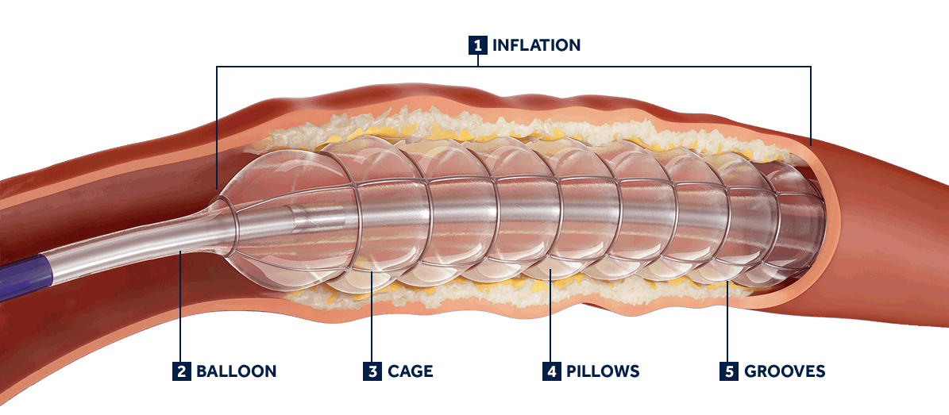
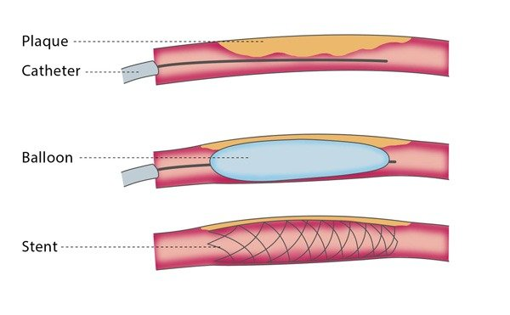
Project Description
Poba Medical wants our team to design and build a radial expansion tester, with controlled temperature and axial load, for the extruded plastic tubes used in the manufacture of their balloon catheters.

Slide 3
Project Description
Poba Medical is a company that manufactures balloons and catheters for a variety of medical purposes.
At the moment, in order to test whether or not a specific balloon design can be made from a type of tube stock, a sample balloon must be manufactured and tested.
This requires new tooling to be purchased and time to be spent making the balloon.
Our project will allow Poba to test the properties of their tube stock and determine if it meets the requirements of a balloon design before making a balloon.

Slide 4
Customer and Engineering Requirements
Customer Requirements:
EGR Requirements:
Constant Axial Force During Testing
Test range of unexpanded diameters
Test range of expanded diameters
Pressurize balloons during testing
Temperature Control During Testing
Ability to read continuous measurements during testing
Constant balloon Pressure During Testing
Constant axial force up to 150 lbs
Test unexpanded diameters ranging from .2-.625”
Test expanded diameters up to 2.5”
Control temperature of extrusion up to 250℉
Continuous measurements of pressure, axial force, and extrusion diameter
Output measurements
*Generated through a meeting with the POBA engineers on 9/2/2021 and the document providing the project description.

Slide 5
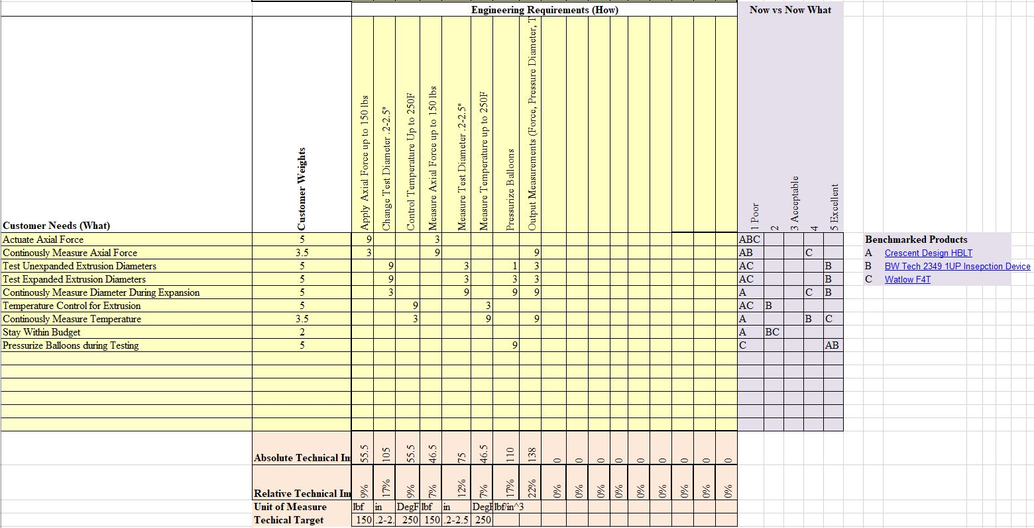
House Of Quality/QFD
Table 1: Bottom Half of QFD

Slide 6
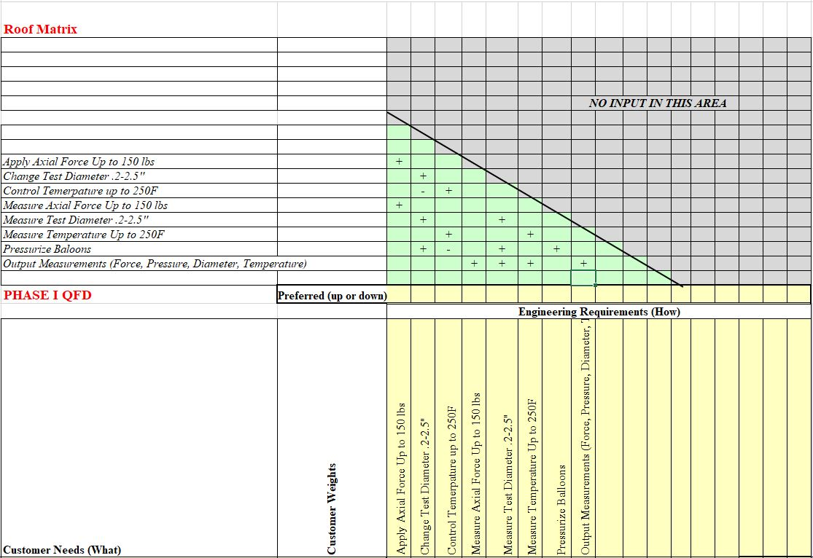
House Of Quality/QFD
Table 2: Top of QFD

Slide 7
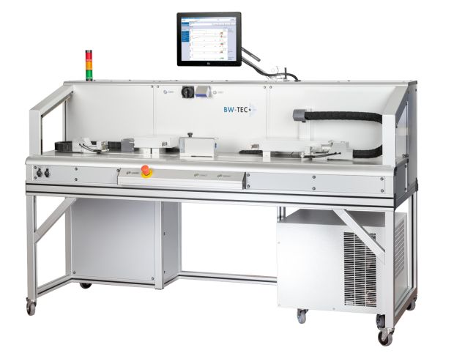
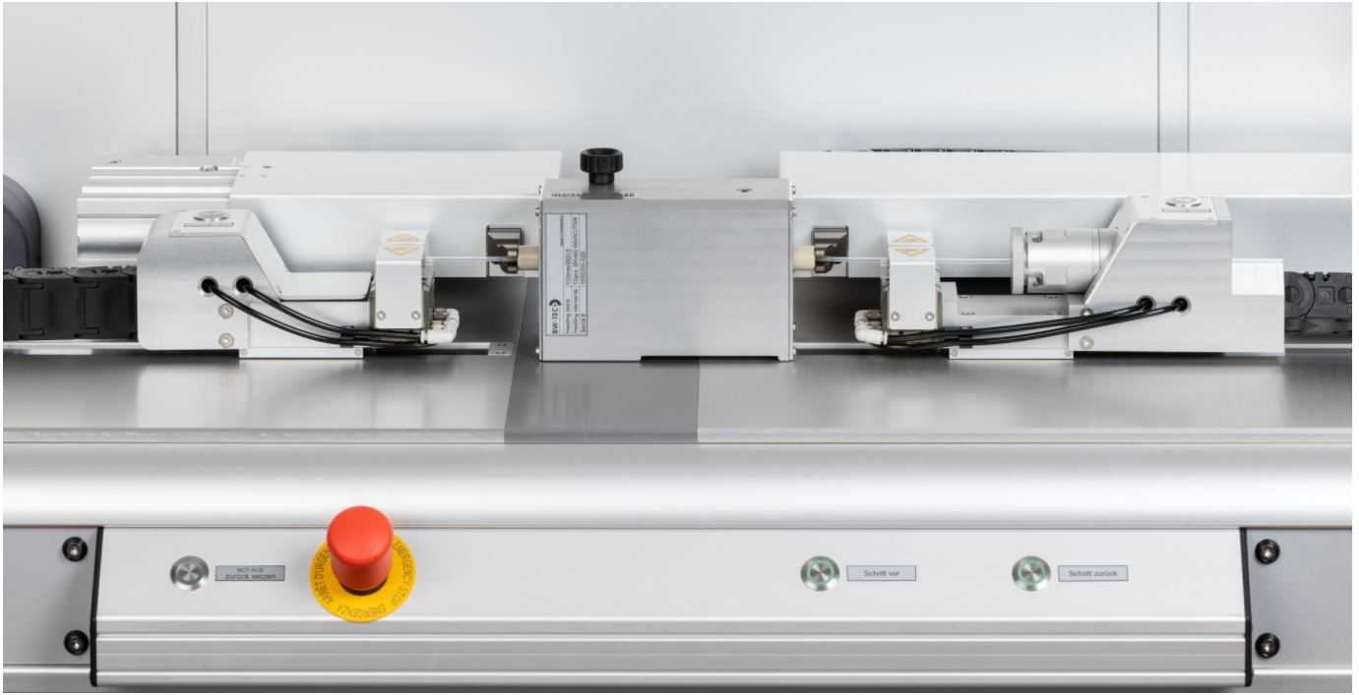
Background and Benchmarking
BW-TEC: Balloon Forming Machine
Creates “Balloons” through blow forming process
Modular design to makes various shapes/ sizes
Wide range of pressure/temperature settings
Touch screen interface/ data logging
Fully automated processing
Expensive ($10,000 just for heating elements!)

Slide 8
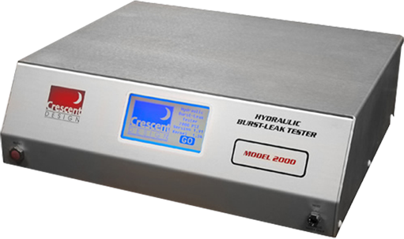
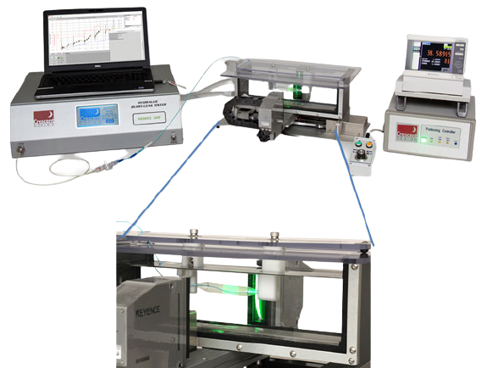
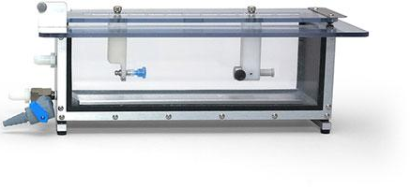
Crescent Design: “Hydraulic Burst Leak Tester”
Pressurized with distilled water (poba specified using nitrogen)
Vacuum to 5,000psi depending on model
Touchscreen interface
For testing various parts: Valves, Tubes, Fittings, IV bags etc.
Compact/ safe design
Add ons
“Optical micrometer” - vision system
“Water baths” - submerged testing
8 or 20 inches of travel
Networked data logging
Automatic position control

Slide 9
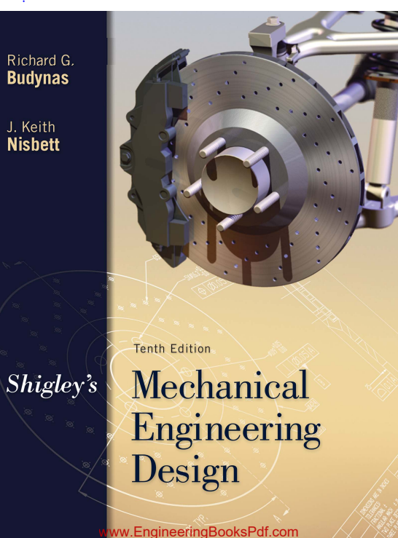
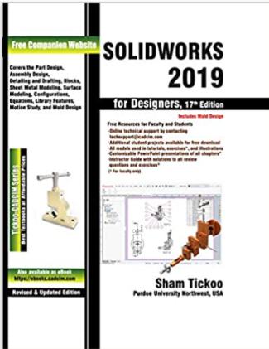

Literature Review - Michael
Shigley's Mechanical Engineering Design 10th Edition Chapters 13-15
-Gear design will be necessary to create a small machine that can apply 150lbs of axial force
SOLIDWORKS 2019 for Designers 17th Edition
-SOLIDWORKS is the premier 3D CAD software
Fundamentals of Heat and Mass Transfer 7th Edition Chapter 3-4
-POBA Engineers recommended using an oil or water bath for our heating element

Slide 10
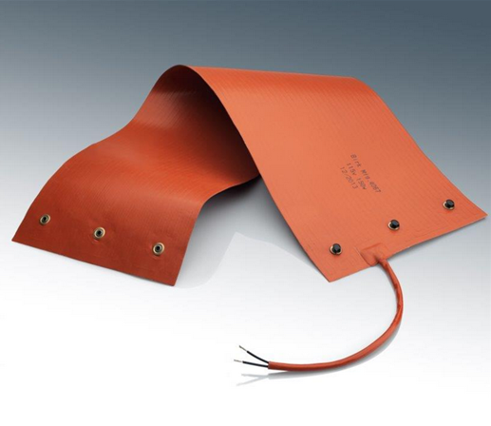
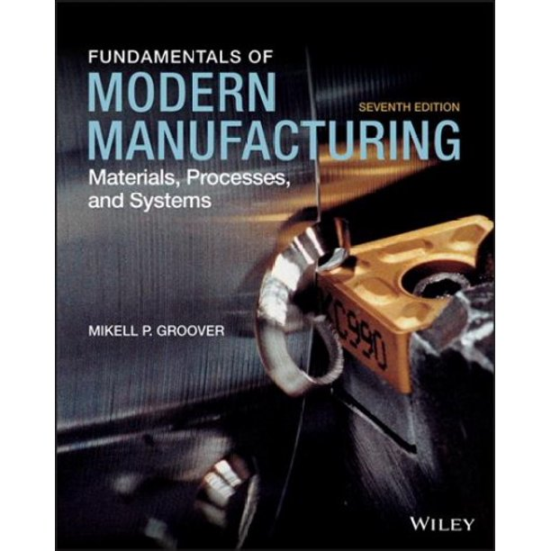

Literature Review - Noah
“Silicone-rubber heaters stretch product utility” Machine Design Vol. 70 Issue 17 p166.
Possible Alternative to the water/oil bath for our heating element
Fundamentals of Modern Manufacturing: Materials, Processes, and Systems 7th Ed. Chapter 13
Describes the blow molding and extrusion processes Poba uses in manufacturing their balloons
Marks’ Standard Handbook for Mechanical Engineers 12th Ed. Section 10
Covers methods for automatically controlling processes such as heating and tensile loading

Slide 11
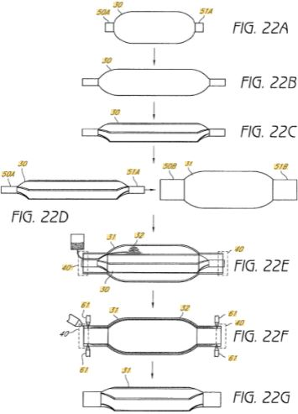
Literature Review - Vergil
Patent: “Methods for manufacturing multilayer balloons for medical applications”
Describes generally a process and considerations for balloon manufacturing
Article: “Comparison of the diameter consistency and dilating force of the controlled radial expansion balloon catheter to the conventional balloon dilators”
Details a process of measurement and comparison of certain styles of balloon catheters
Book: “Pneumatic Drives: System Design, Modeling and Control”
Book that describes setting up and operating pneumatic systems 2\

Slide 12
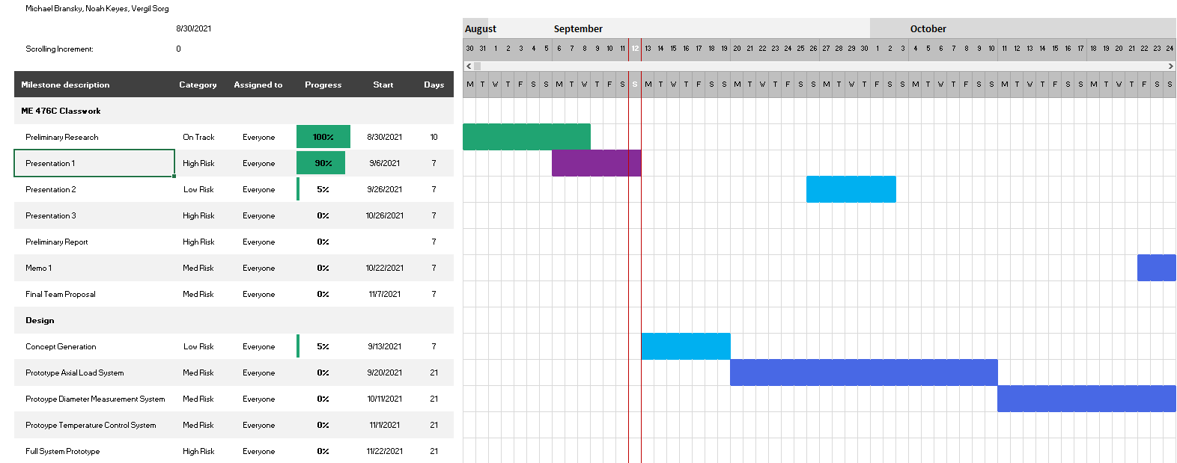
Schedule and Budget
Table 3: Overall Schedule

Slide 13
Schedule and Budget
Important Points:
Team has 1 week to work on group classwork
  Allows team to create good work while still focusing on designing the Radial Expansion Tester
Team has 3 weeks to prototype each subsystem
  Gives team time to iterate on each subsystem
Schedule does not include unforeseen setbacks
  Schedule will likely change as semester continues

Slide 14
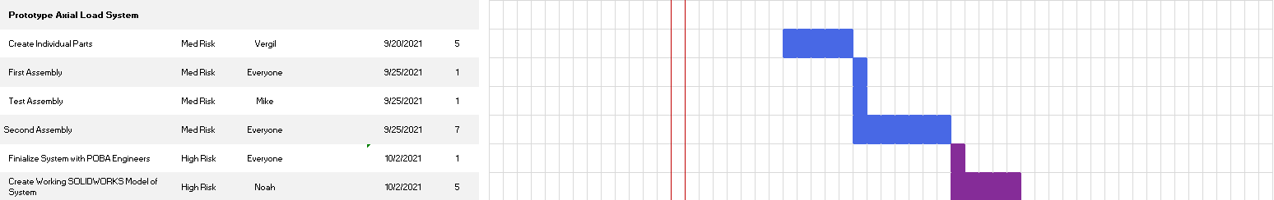
Schedule and Budget
Table 4: Example Prototyping Schedule
3 Week period per subsystem gives team time to iterate
Some subsystems will likely take longer than others

Slide 15
Schedule and Budget
Total budget comes to $5,000 to $10,000.
Due to high component costs, the team will attempt to limit prototyping costs
  Cost can be reduced by creating mockups of full systems to test their validity
  Some systems are more expensive than others
Possibility for slightly more funding if it is shown we are creating a working system

Slide 16
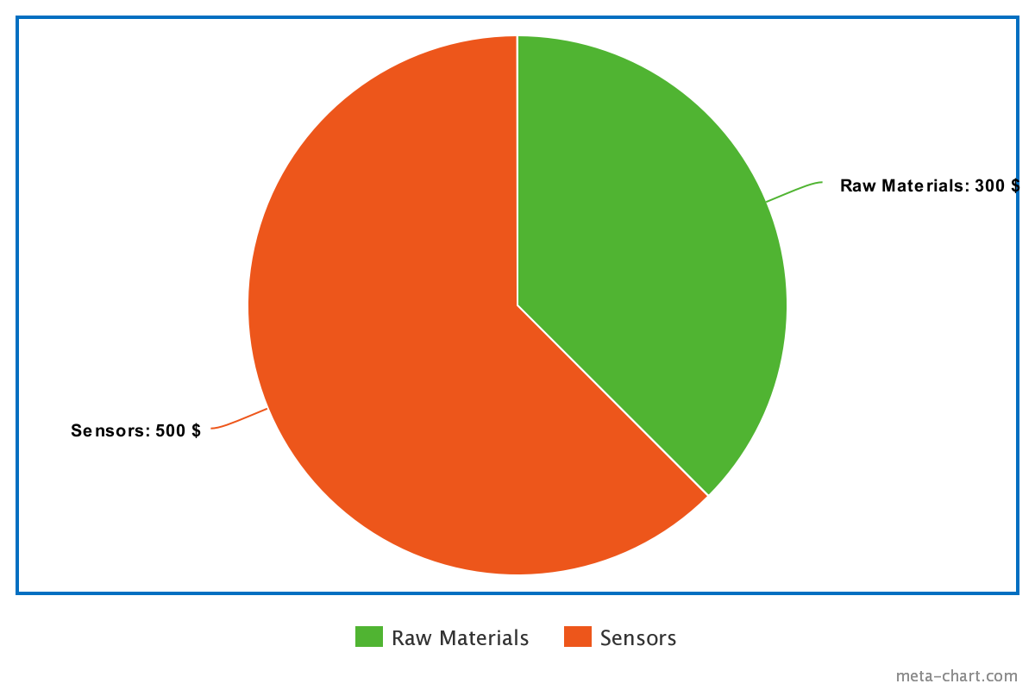
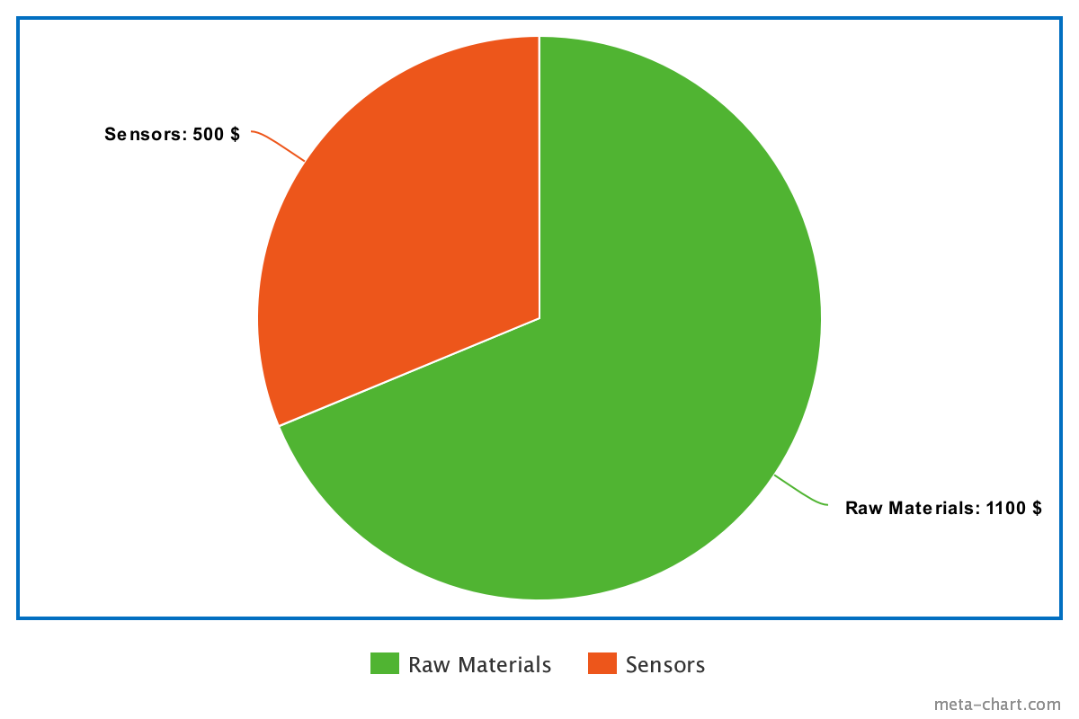
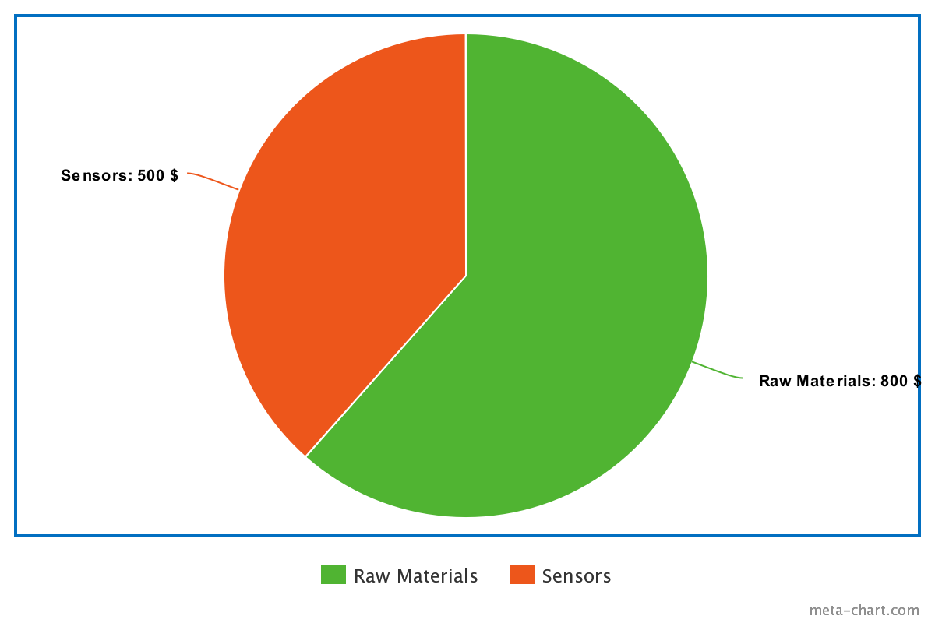
Schedule and Budget
Figure 3: Possible Costs for Temperature Control System
Figure 1: Possible Costs for Axial Load System
Figure 2: Possible Costs for Diameter Control System

Slide 17
Sources Cited
[1] “13-15.” Shigley's Mechanical Engineering Design, by Richard G. Budynas et al., McGraw-Hill, 2016, pp. 665–817.
[2] BERGMAN, THEODORE L. Fundamentals of Heat and Mass Transfer. WILEY, 2020.
[3] Oman, Sarah. “QFD (House of Quality) and Benchmarking.” NAU Lecture. NAU Lecture, 12 Sept. 2021, Flagstaff, Arizona.
[4] “Simple Gantt Chart.” Office Templates & Themes, 12 Mar. 2021, templates.office.com/en-us/Simple-Gantt-Chart-TM16400962.
[5] Tickoo, Sham. SolidWorks 2019 for Designers. CADCIM Technologies, 2019.
[6] 2550 1UP Balloon Forming machine. (n.d.). Retrieved September 13, 2021, from https://www.bwtec.com/machines/2550balloonformingmachine.
[7] Diameter measurement and THE HBLT. Crescent Design. (2018, May 18). Retrieved September 13, 2021, from https://www.crescentdesign.com/hblt/diameter-measurement/.
[8] Multi-layer balloons for medical applications and methods for manufacturing the same. (n.d.).
[9] Goldstein, J. A., & Barkin, J. S. (2000). Comparison of the DIAMETER consistency and Dilating force of the CONTROLLED radial Expansion BALLOON catheter to the conventional BALLOON Dilators. American Journal of Gastroenterology, 95(12), 3423–3427. https://doi.org/10.1111/j.1572-0241.2000.03357.x
[10]Cobb, Peggy, and John R Gyorki. “Silicone-Rubber Heaters Stretch Product Utility.” Machine Design, vol. 70, no. 17, 24 Sept. 1998, p. 166.
[11] Brady, Jennifer, editor. “Shaping Processes for Plastics.” Fundamentals of Modern Manufacturing: Materials, Processes, and Systems, by Mikell P Groover, 7th ed., Wiley, 2019, pp. 232–289.
[12]Murphy, Gregory, et al. “Instruments and Controls.” Marks’ Standard Handbook for Mechanical Engineers, edited by Ali Sadegh and William Worek, 12th ed., McGraw-Hill Education, 2017, pp. 4128–302.

